Slide 1
Designing System Architecture

Slide 2
The Design Process
Design is the creative process of figuring out how to implement all of the customer’s requirements; the resulting plan is also called the design
Early design decisions address the system’s architecture
Later design decisions address how to implement the individual units

Slide 3
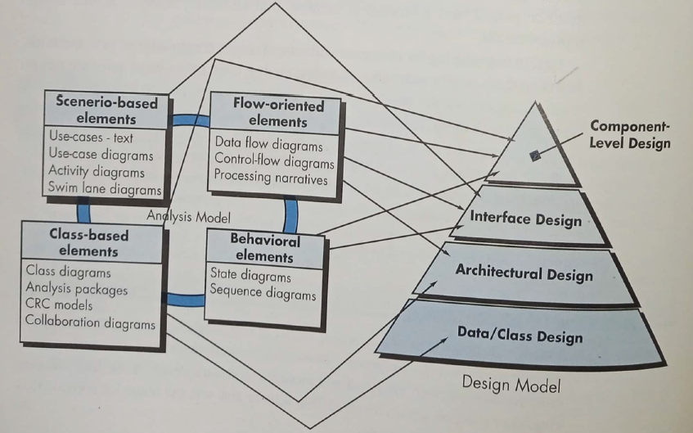
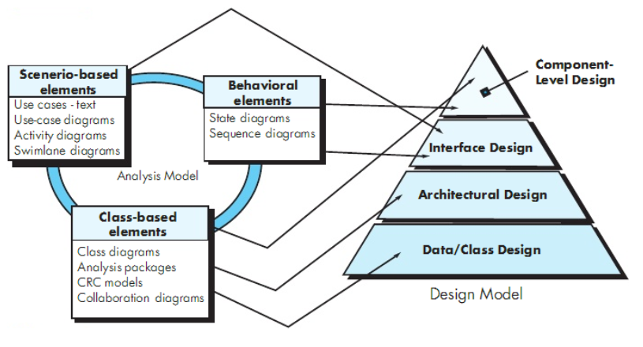
Translating Requirements to Design

Slide 4
Design or Requirements?
A room for three children to play and a separate place for them to sleep
A room for parents
A room for cooking
Heating for the winter and cooling for the summer
Indoor water and electricity

Slide 5
Multiple Designs?
Maximize playing area
Minimize playing area
Large bedrooms
Two storey house
Single storey house
Which is the best design?
Will a proposed solution result in modified requirements?

Slide 6
The Design Process Design is a Creative Process
Design is an intellectually challenging task
Numerous possibilities the system must accommodate
Nonfunctional design goals (e.g., ease of use, ease to maintain)
External factors (e.g., standard data formats, government regulations)
We can improve our design by studying examples of good design
Most design work is routine design, solve problem by reusing and adapting solutions from similar problems

Slide 7
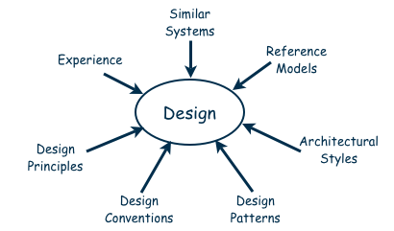
The Design Process Design is a Creative Process (continued)
Many ways to leverage existing solutions
Cloning: Borrow design/code in its entirety, with minor adjustments
Reference models: Generic architecture that suggests how to decompose the system

Slide 8
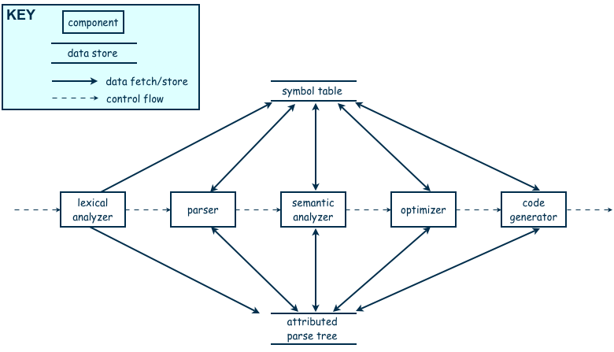
The Design Process Design is a Creative Process (continued)
Reference model for a compiler

Slide 9
The Design Process Design is a Creative Process (continued)
More typically, a reference model will not exist for the problem
Software architectures have generic solutions too, referred to as architectural styles
Focusing on one architectural style can create problems
Good design is about selecting, adapting, and integrating several architectural design styles to produce the desired result

Slide 10
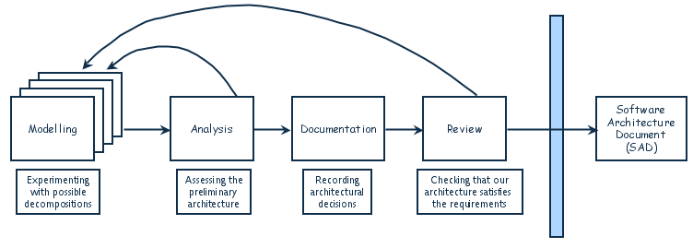
The Design Process Design is an Iterative Process (continued)
The designers move back and forth among activities involving:
Understanding requirements, proposing solutions, testing feasibility of a solution, presenting possibilities to the customers, documenting the design for programmers
The final outcome is the software architecture document (SAD)

Slide 11
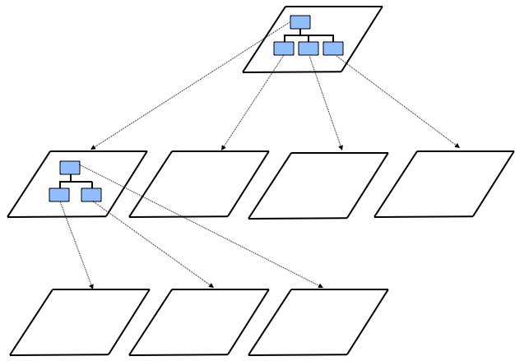
Decomposition and Views
High-level description of system’s key elements
Creating a hierarchy of information with increasing details
Top
level
First level of
decomposition
Second level of
decomposition

Slide 12
Decomposition and Views Popular Design Methods
Some design problems have no existing solutions
Designers must decompose to isolate key problems
Some popular design methods:
Functional decomposition
Feature-oriented decomposition
Data-oriented decomposition
Event-oriented decomposition
Object-oriented decomposition

Slide 13
Decomposition and Views Popular Design Methods
Functional decomposition
partitions functions or requirements into modules
begins with the functions that are listed in the requirements specification
lower-level designs divide these functions into subfunctions, which are then assigned to smaller modules
describes which modules (subfunctions) call each other

Slide 14
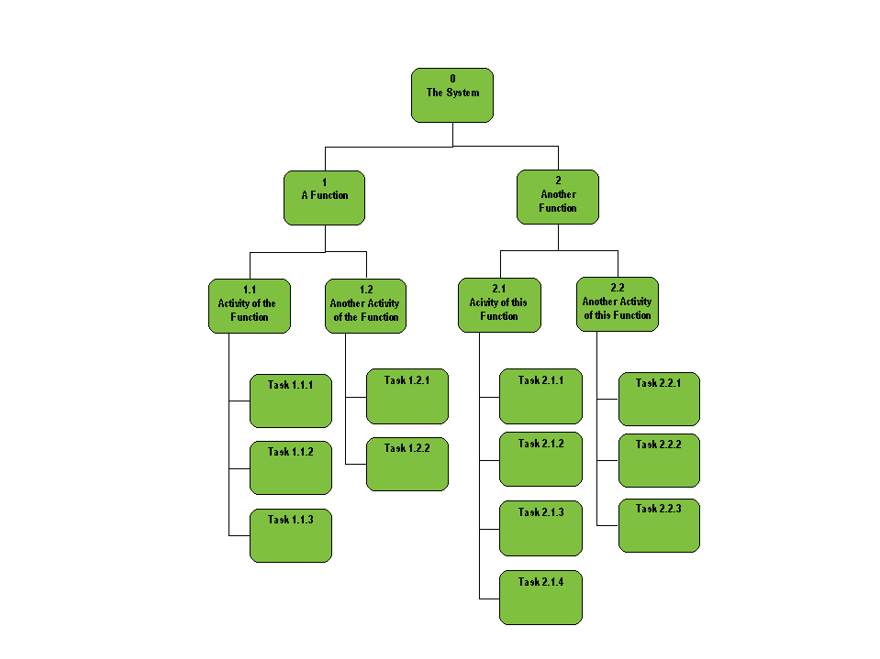
Quiz System
Student Tasks Management
Submission Management
Submission Verification
Submission Storage
Quiz Conduction and Display
Faculty Tasks Management
User Management
Quiz Management
Quiz Generation
Question Management
Report Management
Grading
Image source: http://afis.ucc.ie/gkiely/IS1100_OLD/Lectur8.gif
Attempt Reporting

Slide 15
Functional Decomposition Example
Student Registration System
Data Entry Validation
Transaction Verification
Report Generation
Data Updation
Student Data Validation
Course Data Validation
Transaction Checks
Addition Modules
Deletion Module

Slide 16
Decomposition and Views Popular Design Methods (continued)
A design is modular when each activity of the system is performed by exactly one software unit, and when the inputs and outputs of each software unit are well-defined
A software unit is well-defined if its interface accurately and precisely specifies the unit’s externally visible behavior

Slide 17
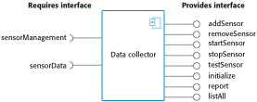

Decomposition and Views Sidebar 5.2 Component-based Software Engineering
Component-based software engineering (CBSE) is a method of software development whereby systems are created by assembling together preexisting components
A component is “a self-contained piece of software with a well-defined set of interfaces” that can be developed, bought, and sold as a distinct entity
The goal of CBSE is to support the rapid development of new systems, by reducing development to component integration, and to ease the maintenance of such systems by reducing maintenance to component replacement
At this point, APIs are used as constructs to abstract complex code

Slide 18
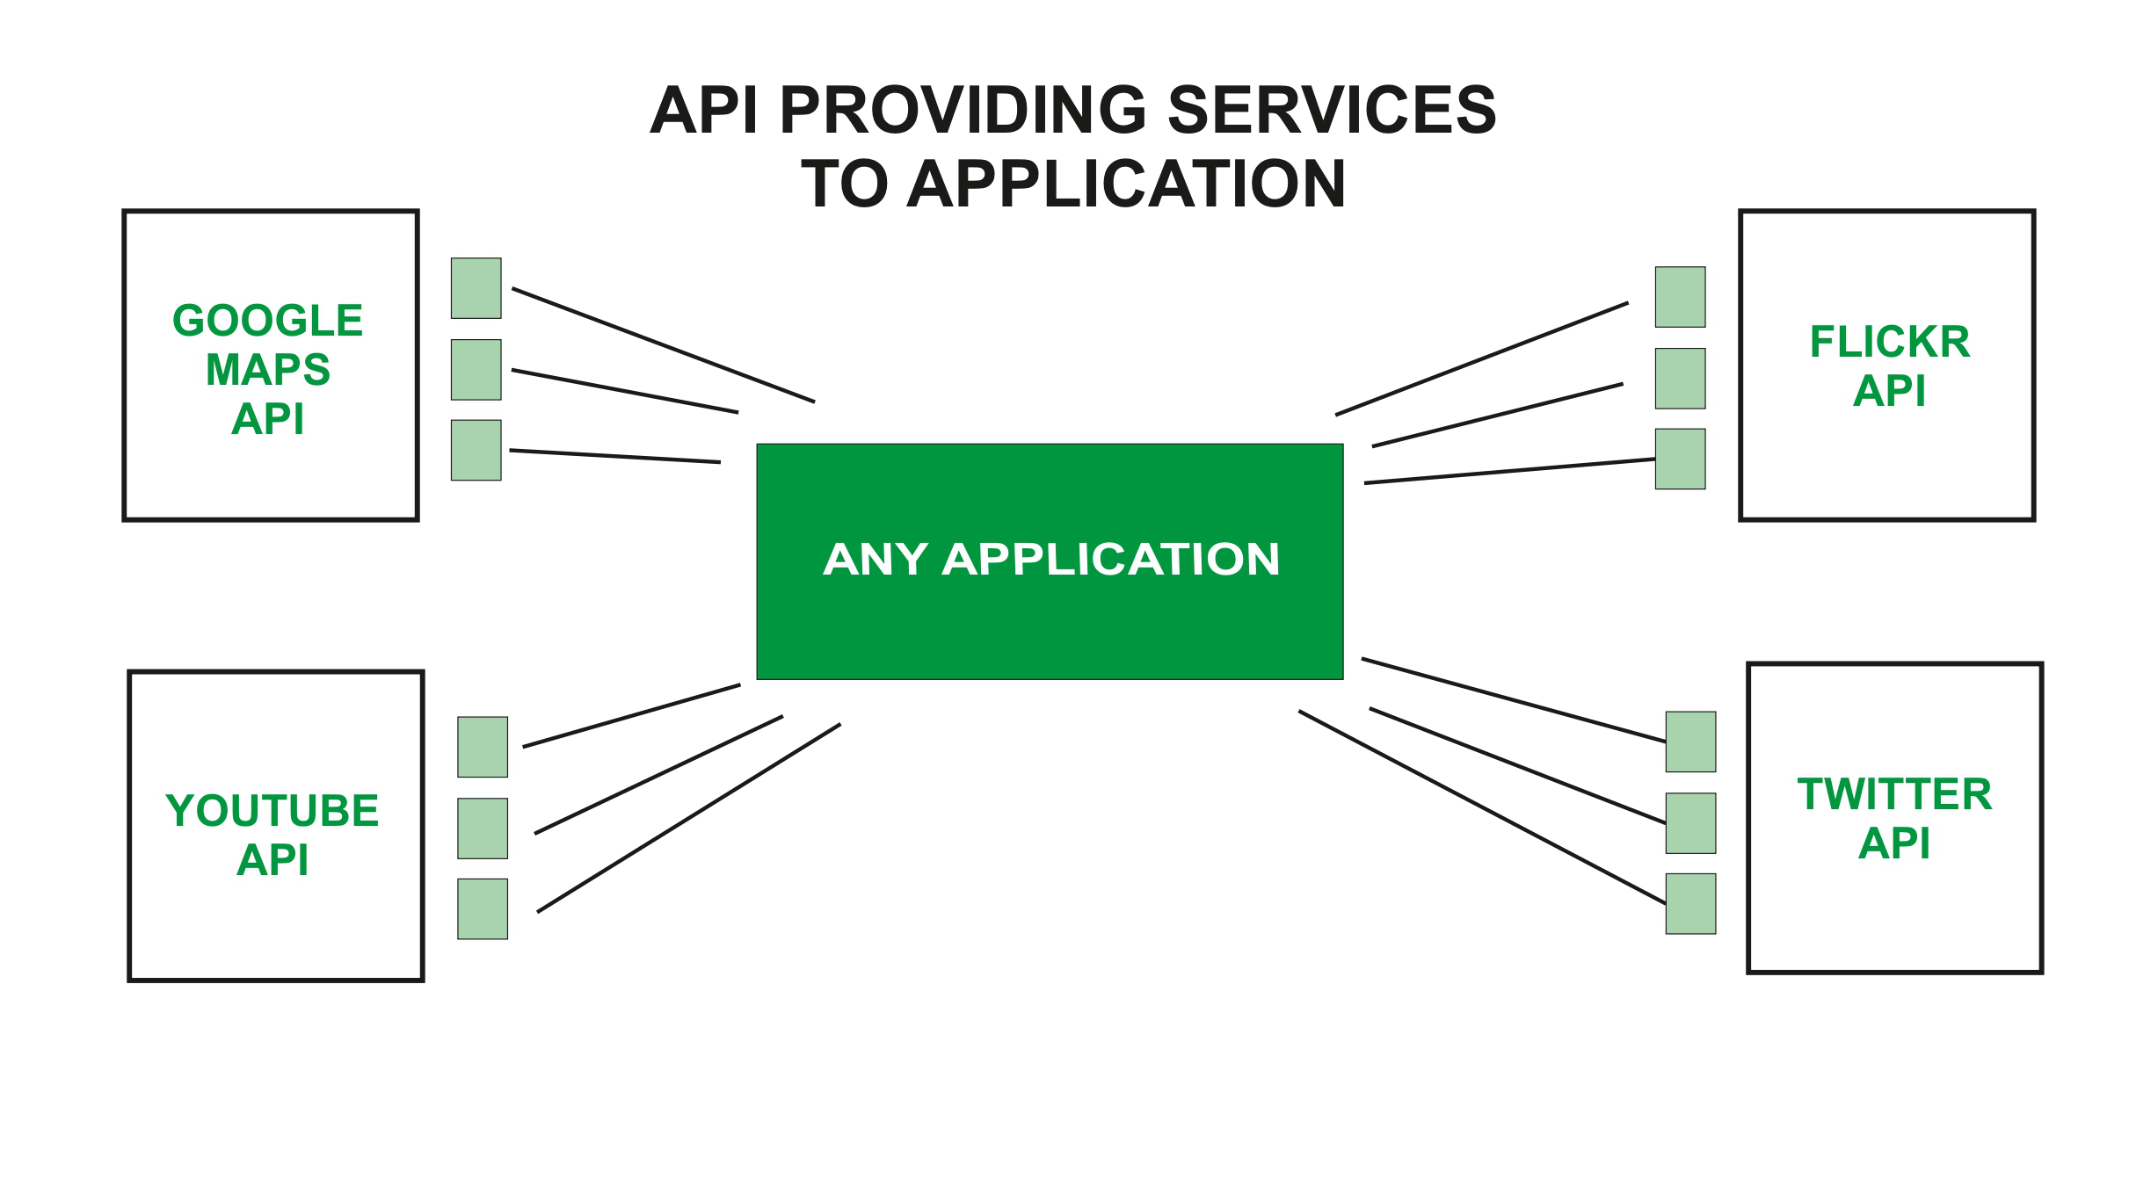
Example
Source: https://www.geeksforgeeks.org/what-is-web-api-and-why-we-use-it/

Slide 19
Design Methodology
We have an abstract description of a solution to our customer’s problem, a software architectural design, a plan for decomposing the design into software units and allocating the system’s functional requirements to them
No distinct boundary between the end of the architecture-design phase and the start of the module-design phase
No comparable design recipes for progressing from a software unit’s specification to its modular design
The process taken towards a final solution is not as important as the documentation produced

Slide 20
Design Methodology
Design decisions are periodically revisited and revised
Refactoring
to simplify complicated solutions or to optimize the design

Slide 21
Design Documentation
The details of the system architecture is documented in Software Architecture Document (SAD)
SAD serves as a bridge between the requirements and the design
Detailed (or module) design acts as a bridge from architecture design to code
Many ways to document the design
Design by contract: a particular approach that uses the documentation not only to capture the design but also to encourage interaction among developers

Slide 22
Design Documentation Design by Contract
In design by contract, each module has an interface specification that precisely describes what the module is supposed to do
Meyer (1997) suggests that design by contract helps ensure that modules interoperate correctly
This specification, called a contract, governs how the module is to interact with other modules and systems
Such specification cannot guarantee a module’s correctness, but it forms a clear and consistent basis for testing and verification
The contract covers mutual obligations (the preconditions), benefits (the postconditions), and consistency constraints (called invariants)
Together, these contract properties are called assertions

Slide 23
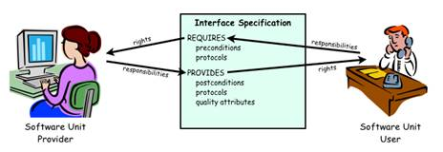
Design Documentation Design by Contract (continued)
Design contract between software provider and user

Slide 24
References
SE book by Pfleeger
SE book by Pressman
SE book by Ian Sommerville
UCF slides for SE course (a few slides have been reused)

